Slide 1
44T-GR8 PROJECT 2

Slide 2
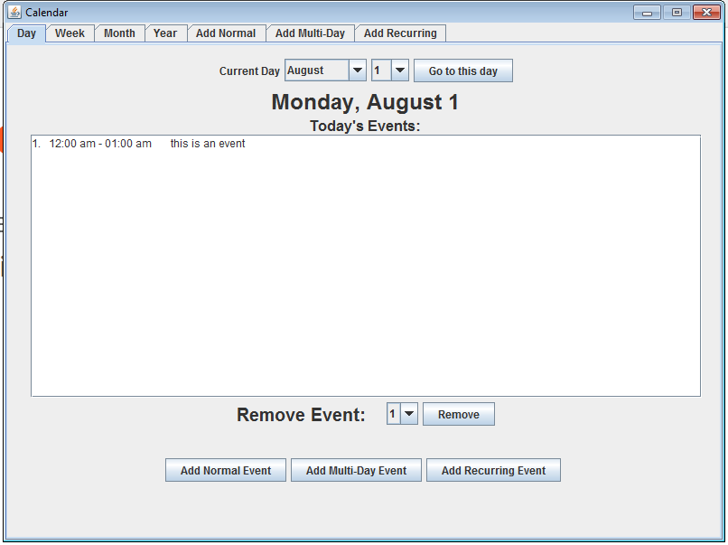
Overview
Group members: Alex Griffin, Nick Bukaty, Thomas Doty, David Cuellar, and Matthew Kravitz
We used Java as our platform, and used JFrame to generate it.

Slide 3
Division of Labor
Alex: Backend, normal and multi-day functionality Thomas: Created the graphical user interface for adding events David: Early iterations of event class Matt: Created the GUI for adding events Nick: Backend, recurring events functionality

Slide 4
Challenges
Adapting to a new format to add various kinds of events
Switching to serialization instead of text files for event storage
Working with JFrame to create the GUI

Slide 5
Excluded Features
Color coding for type of event
Functionality outside of the school year
Clean up of the code base

Slide 6
What we would do different
Planned more extensively in the meetings and stick to that plan
Splitting up the labor better
Use only one tab for all the events
Make it look nicer (Bigger font, color)

